Slide 1

On Becoming a Leader in Risk Management
Fundamentals of RM
RM System and Process
Leadership in RM
Incident Investigation
RM Tools & Challenges
RM in Industry
People & Org.
Applications & Perspectives
ENGG404 - Lecture
Chapter 1.1: The Engineer’s Survival Guide - Applied (Part 2)
1

Slide 2
Learning Outcomes:
Judge a situation where issues/concerns are evident or perceived, in order to make a decision or recommendation.
Make decisions in an enabled and empowered manner, when faced with confusing or conflicting or incomplete information, guidance, direction, or messaging, and often under significant time constraints.
Chapter 1.1: The Engineer’s Survival Guide - Applied
2

Slide 3
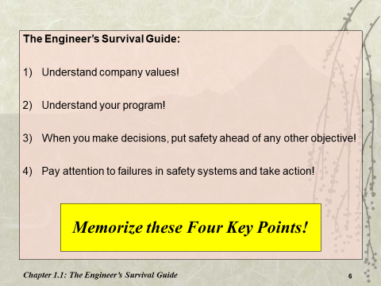
How To Apply the Key Points:
The Key Points can be applied in any situation for any decision-making process e.g. a case study or a dilemma in the workplace.
The purpose is to make a decision or recommendation consistent with the Engineer’s Survival Guide:
Given the available data, information, and resources,
In order to maximize or optimize the realization of a desired outcome or acceptable condition.
Memorize!
Chapter 1.1: The Engineer’s Survival Guide - Applied
3

Slide 4
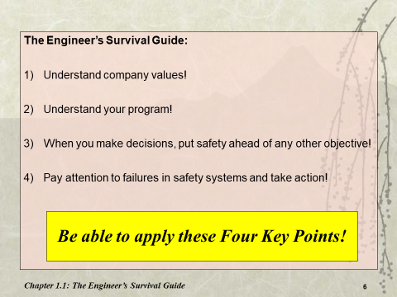
How To Apply the Key Points:
Consider these points and answer in terms relative to a Key Point:
What is the Loss Incident?
What Key Point is being applied?
What is the situation?
What is the issue with that situation, in terms relative to the selected key point?
What would you have done or what should you have done, again in terms relative to the selected key point?
What would have been the probable outcome had it been done?
Case Study #1 Example in your handbook demonstrates the depth of application expected in the class.
Apply!
Chapter 1.1: The Engineer’s Survival Guide - Applied
4

Slide 5
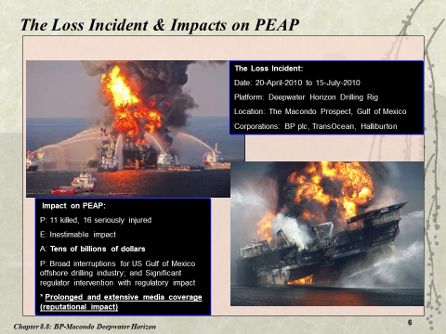
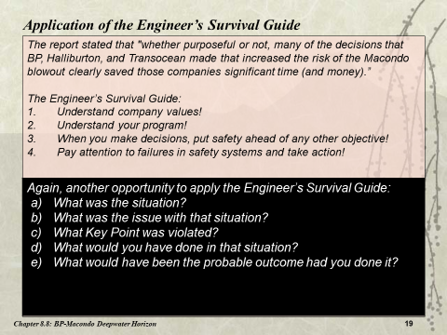
Recall BP-Macondo Deepwater Horizon LI:
Chapter 1.1: The Engineer’s Survival Guide - Applied
5

Slide 6
The Framework to Apply One of the Key Points:
Quoted from Chapter 1.1 of your Textbook.
What is the Loss Incident?
The loss incident is that which is being examined in the course, the team project loss incident under study, or work experience. This is a simple statement of facts such as the facility, the location, and the nature of the loss incident. In some cases, the title is sufficient.
What Key Point is being applied?
This is one of the Four Key Points. State it!
What is the situation?
This is the description of the activity that covers three points:
The facility or operation;
The hazards and risks posed by the facility / operation prior to the loss incident;
A brief summary of any deficiencies in the control measures of the activity.
This is NOT a long description of the sequence of events of the loss incident.
What is the issue with that situation?
This drives into the details of the deficiencies in the control measures of the activity leading to the particular loss incident and relates the situation / circumstance to the issue or concern in terms relevant to the selected Key Point. This can be best described by the hazard (process or occupational), the risk of that hazard becoming uncontrolled under the current deficiencies, and a notion about management’s awareness of the issue or concern. Articulate this in terms of the selected Key Point if not obvious.
What should have been done?
Describe one action (or more) that would address the concern, how that action addresses that concern, and how that action is aligned with satisfying the selected Key Point (if not obvious).
What would have been the probable outcome had it been done?
Describe the status of the risk / hazard associated with the activity, and the outcome of the activity.
With your colleague, select and apply one of the Four Key Points to ANY situation on the BP-Macondo Deepwater Horizon Loss Incident. Advance to the next slide to get you started. Please confer for 5 minutes. (Not MM)
Chapter 1.1: The Engineer’s Survival Guide - Applied
6
Notes:
An Example: Apply the Key Points of the ESG
a) What is the Loss Incident? BP-DWH offshore drilling rig, Gulf of Mexico off the coast of Louisiana
b) What Key Point is being applied? KP #3: Put safety ahead of any other objective.
c) What is the situation?
The drilling deck and downhole operation where the well is being cemented and completed.
Downhole pressure is controlled by mud density and by the cement plugs at completion. If the downhole pressure exceeds mud density or cement plugs, then an uncontrolled “kick” or blowout can happen i.e. gas and oil blow-out onto the drilling deck and rig, and pose a fire risk.
Improper mud density control or inferior completion / hardening of the cement plugs can lead to an inability to contain high down-hole pressures. If this situation becomes uncontrolled, the well could blow-out. The blow-out preventer (BOP) is the last line of defense for stopping a blow-out.
d) What is the issue with that situation?
The issue was that management made the decision to proceed with completion of the well (retract the downhole drilling tools and cement the well), despite known deficiencies including: the mud density, the less than the recommended number of cement plugs, and the less than the recommended cure time for the cement plugs.
In other words, management rushed to complete the well, a major project milestone, and move on to the next stage of the project even though certain control measures were not as effectively implemented as they could be. This violated “Put safety ahead of any other objective”.
e) What should have been done?
The mud density should have been increased to contain the pressure. More cement plugs should have been installed to complete the well (contain the pressure). More time should have been allowed to cure (harden) the cement plugs and complete the well. Any / all three of these actions would decrease the likelihood of an uncontrolled kick and blow-out. These actions demonstrate “put safety ahead of any other objective”.
f) What would have been the probable outcome had it been done?
With the control measures in place, there would not have been an uncontrolled blowout, no explosion, and no fire. The loss incident would have been prevented, and there would not have been any impacts on PEAP.

Slide 7
Summary and Key Lessons:
The ESG is a corner-stone for assessing case studies … … and real-world situations in which you will find yourself during your career!
You should be able to:
Judge a situation where issues/concerns are evident or perceived, in order to make a decision or recommendation.
Make decisions in an enabled and empowered manner, when faced with confusing or conflicting or incomplete information, guidance, direction, or messaging, and often under significant time constraints.
You should be able to apply any one of the key points of The Engineer’s Survival Guide to your team project loss incident or a real workplace experience!
Chapter 1.1: The Engineer’s Survival Guide - Applied
7

Slide 8
An Example: Apply the Key Points of the ESG
a) What is the Loss Incident? BP-DWH offshore drilling rig, Gulf of Mexico off the coast of Louisiana
b) What Key Point is being applied? KP #3: Put safety ahead of any other objective.
c) What is the situation?
The drilling deck and downhole operation where the well is being cemented and completed.
Downhole pressure is controlled by mud density and by the cement plugs at completion. If the downhole pressure exceeds mud density or cement plugs, then an uncontrolled “kick” or blowout can happen i.e. gas and oil blow-out onto the drilling deck and rig, and pose a fire risk.
Improper mud density control or inferior completion / hardening of the cement plugs can lead to an inability to contain high down-hole pressures. If this situation becomes uncontrolled, the well could blow-out. The blow-out preventer (BOP) is the last line of defense for stopping a blow-out.
d) What is the issue with that situation?
The issue was that management made the decision to proceed with completion of the well (retract the downhole drilling tools and cement the well), despite known deficiencies including: the mud density, the less than the recommended number of cement plugs, and the less than the recommended cure time for the cement plugs.
In other words, management rushed to complete the well, a major project milestone, and move on to the next stage of the project even though certain control measures were not as effectively implemented as they could be. This violated “Put safety ahead of any other objective”.
e) What should have been done?
The mud density should have been increased to contain the pressure. More cement plugs should have been installed to complete the well (contain the pressure). More time should have been allowed to cure (harden) the cement plugs and complete the well. Any / all three of these actions would decrease the likelihood of an uncontrolled kick and blow-out. These actions demonstrate “put safety ahead of any other objective”.
f) What would have been the probable outcome had it been done?
With the control measures in place, there would not have been an uncontrolled blowout, no explosion, and no fire. The loss incident would have been prevented, and there would not have been any impacts on PEAP.
Chapter 1.1: The Engineer’s Survival Guide - Applied
8

